Slide 1
RPA Blue Prism Developer Standards

Slide 2
Background
Objective and benefits
The objective of using the RPA Design Standards template is to share leading practices for BP development and assist in : Developing a robust and resilient RPA solution from start to finish Leverage key learnings and challenges faced from other projects Enable fast roll-out of high quality RPA code
How to use this tool
This tool is to guide the RPA implementation team with respect to leading practices on BP standards of development globally.
When to use this tool/enabler
During the design and sprint phase of the RPA PoC to align to existing development standards.

Slide 3
Table of Content
Process Design……………………………………………………………………3
Object Design……………………………………………………………………...8
Work Queue Management………………………………………………………18
Release Management……………………………………………………………xx

Slide 4
1. Process Design

Slide 5
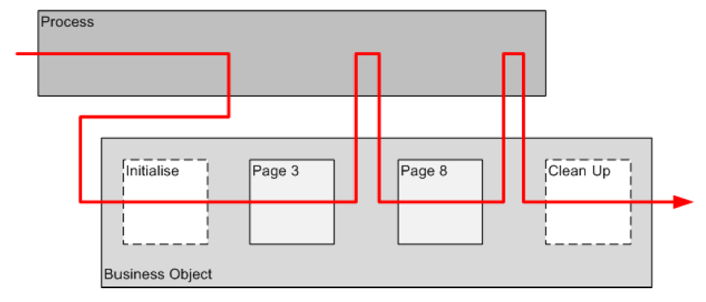
Process and Object Interactions
Robotic Process Automation follows an intuitive and straightforward design process
In its core, a process supports the coordination and sequencing of steps and decision points that the process undertakes whereas the object supports the interaction between the applications within the process.
All business logic and complexity is built into the process layer
Objects are intended to be incredibly simplistic, devoid of business logic and only for direct interactions with systems
Example: Sequence of steps between the process and object
The process starts.
The process calls the ‘Launch’ object and returns to the process once the application is launched.
The process step (search customer account) calls the object and writes into page 1 of the object (W – Search Accounts). The process inputs the account number into the object and returns to the process.
The process step (read account balance) calls the object and reads page 3 of the object (R – Customer Account). The process inputs the field to read (Account balance). The object outputs the account balance to the process.
The process (within the process layer) makes a decision on the path to follow using the account balance rule.
Example of process / object interactions:

Slide 6
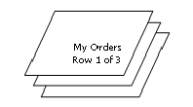
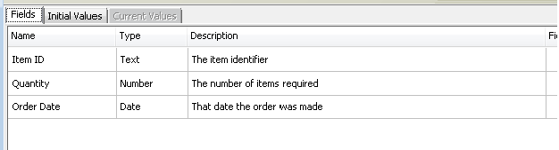
Collections
A Collection is a type of Data Item that can hold multiple values arranged like a table with columns and rows, similar to an Excel spread sheet
Example of a collection:
Points to note in designing collections
Its important to identify the data items to be included in the collection before implementing the collection in the process. As the process expands, each time a new data item is required to be added, this introduces complexity as testing is required to ensure the data items are correct
Spelling and the naming convention of data items up front is core to identifying the data item being leveraged in the process at a later step. If the data item name is not clear and unique, it may get confused with other data items

Slide 7
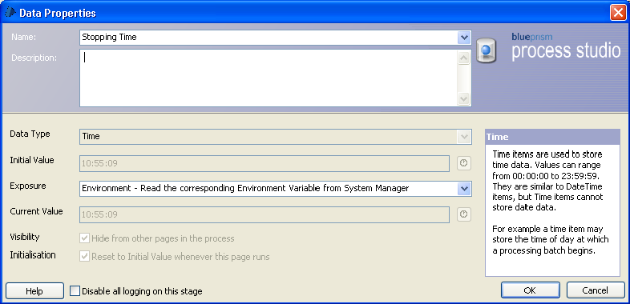
Environment Variables
An Environment Variable is a value that is made available to all Processes and Business Objects, i.e. across the environment. Once in production, there will be no access to edit a process or an object
It is important to identify variables within the process that will change as the process is promoted through different environments. This will enable transition between Development, Test and Production environments without the need to edit the underlying processes and objects
Examples
File Paths of external documents (excel, word etc)
Application launch paths (CommSee, HLS, eDocs)
C:\Program Files (x86)\Blue Prism Limited\Blue Prism Automate\VBO
Credentials (Login Credentials)
Select Exposure to
expose the variable
to the control room

Slide 8
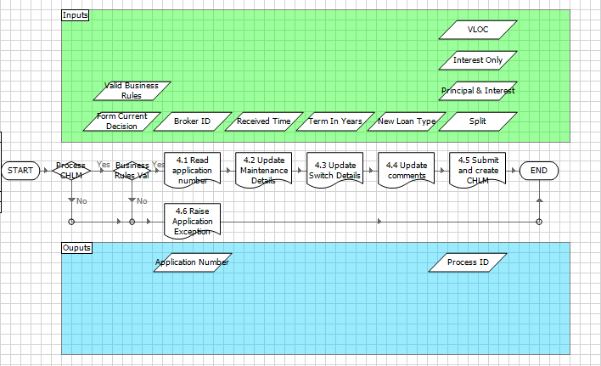
Process Layout
Data inputs and outputs should be clearly identified and grouped on the Main page of each process
Blocks
Data items or collections that are inputs should sit above the process in a block
Data items or collections that are outputs should sit below the process in a block
Note: These blocks are also used for exception handling when placed over a set or all of the process stages. Blocks can catch an exception so that the process can be recovered and resumed ensuring the process does not fail completely.

Slide 9
2. Object Design

Slide 10
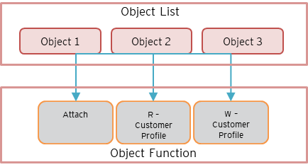
Object Design
Object development is the CORE to a successful RPA solution. The use of:
A well defined naming convention (across objects, object pages and object elements)
Having objects with a maximum count of pages, up to 20 (to simplify locating pages)
Applying a clear structured flow within the object page
The application of these principles will enable a highly re-usable, scalable and resilient object designed for enterprise wide use
Example
Rule: An object (application) can contain multiple pages (UI screens) containing multiple elements (elements on a screen) for use by a process.
Object | Function
Object 1 | Attach
Object 1 | R – Customer Profile
Object 1 | W - Customer Profile
Object 2 | N - Customer Profile
Object 2 | RWN - Customer Profile

Slide 11
Object Design Naming Conventions
Type | Instructions /Detail | Example
Object Name | The name of the application should be used | CommSee
Object Page Name | The name of a object page should map to a read, write or navigate to a UI screen in the application This name should be unique so that it is easily identifiable with its corresponding screen | W – Customer Profile R – Customer Profile N - Customer Profile
Object Element Name | The name of the element on the specific page that the object is interacting with. | First Name Last Name D.O.B
Object Page Name Example
Use a verb to communicate the purpose of the page. For example, ‘Read Account History’ or ‘Write Account History’ is much better than just ‘Main Menu’.
Note: As the object page count increases, the object pages should be alphabetically order within the N, R, W structure to assist with identification of pages.

Slide 12
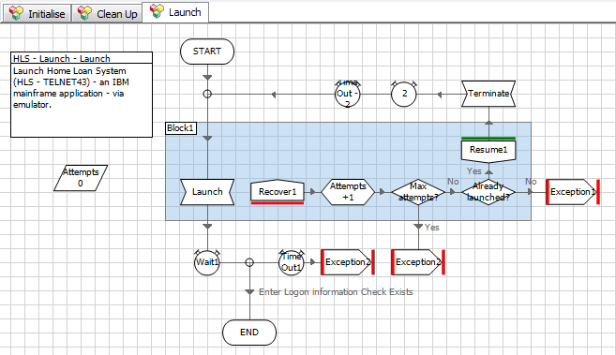
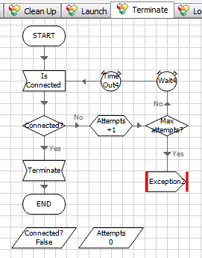
Object Design – Launch and Terminate
Launch Object
The Launch object is a dedicated object for each target application containing only 3 pages:
Initialize
Clean Up
Launch
It is used for launching the application where the target application needs to be started up by Blue Prism
Note: Launch is a standalone object due to the Initialise page of other objects containing the ‘attach’ action.
Terminate Page
The Terminate page is a dedicated page for Blue Prism to close down the application

Slide 13
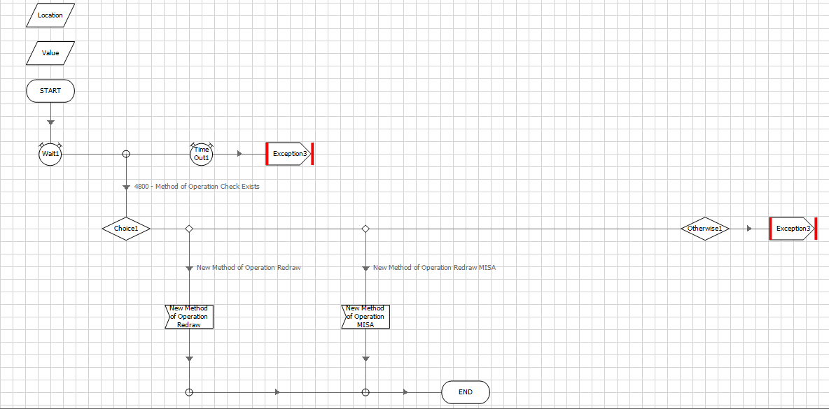
Object Design – Object Flow (Read Objects)
Each page has the following logic:
A check to determine if the screen exists (using a primary screen element)
A choice to determine which element (termed ‘Location’ for choice stage) on the screen to interact with (based on object input)
Exceptions: Not on screen, element not found on screen
Flow Example: R – Account Details (Read)
The read stage can extract information from a given section of a screen. It has one input and one output:
Location (input) – the position on the page that you wish to read i.e. which element to interact with
Value (output) – the content that you want to read
** The process requests to read the object element (passing in the location name, and the value of the element is returned as an output to the process.

Slide 14
Object Design – Object Flow (Write Objects)
Each page has the following logic:
A check to determine if the screen exists (using a primary screen element)
A choice to determine which element (termed ‘Location’ for choice stage) on the screen to interact with (based on object input)
Exceptions: Not on screen, element not found on screen
Flow Example: W – Account Details (Write)
The write stage can input information into a given section of a screen. It has two inputs and no outputs:
Location (input) – the position on the page that you wish to read i.e. which element to interact with
Value (input) – the content that you want to write
** The process requests to write into the object element (passing in the location name and the value to be written)

Slide 15
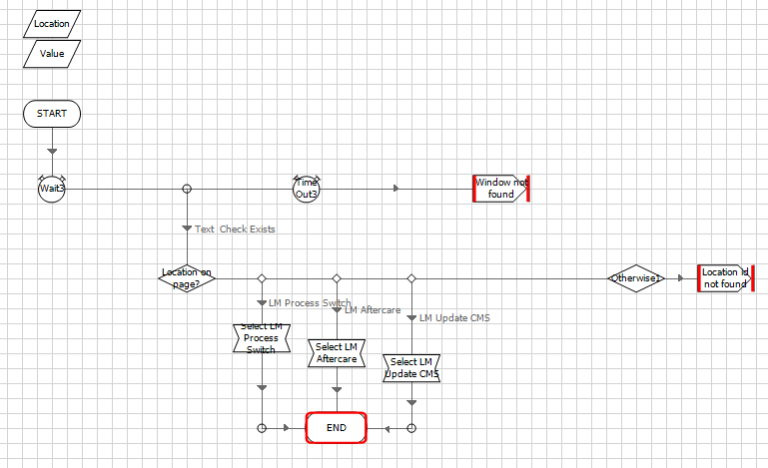
Object Design – Object Flow (Navigate Objects)
Each page has the following logic:
A check to determine if the screen exists (using a primary screen element)
A choice to determine which element (termed ‘Location’ for choice stage) on the screen to interact with (based on object input)
Exceptions: Not on screen, element not found on screen
Flow Example: N – Work Items (Navigate)
The navigate stage can navigate (by clicking / selecting), on a section of a screen. It has one input:
Location (input) – the position on the screen that you wish to manipulate i.e. which element to interact with
(Click or select)
** The process requests to navigate into the object element (passing in the location only)

Slide 16
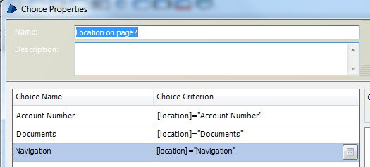
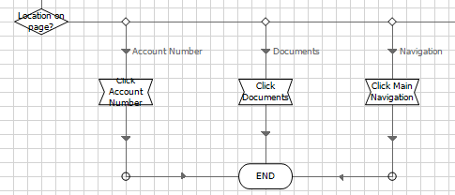
Object Design – Element Naming Conventions
Careful consideration should be taken when naming elements in Application Modeler
To eliminate ambiguity and confusion, it is key to keep names consistent across:
Element name,
[Location] input name
Choice name
This mitigates errors that arise from having multiple names when referring to the same element
Example: Choice Name is the same as Location input, which is the same as element name.

Slide 17
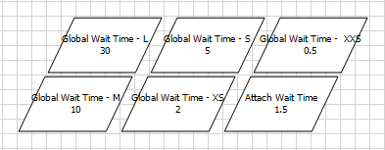
Object Design – Wait Timers
It is key to always check the screen ‘exists’ before completing any action (read/write/navigate)
The Wait stage is used to enable a Business Object to pause and wait for an application element to be available before proceeding to run the action
In addition, this allows a Business Object to deal with potentially erratic application performance. On success, the object can then apply the action to the associated screen element
Global Wait Times
Size | Seconds
XL | 60
L | 30
M | 10
S | 5
XS | 2
XXS | 0.5
It is best practice to define Global wait times on the Initialise page to ensure standardisation throughout the RPA project. You can also make these environment variables, as they can be easily adjusted by process control when systems experience unusually high latency.

Slide 18
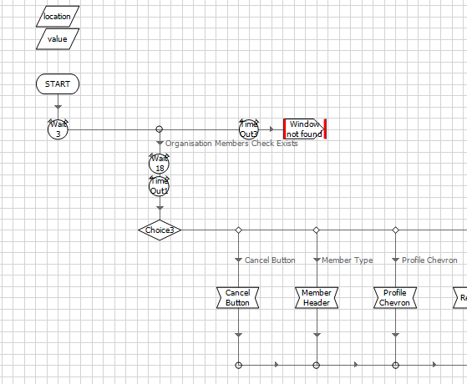
Object Design – Object Flow and Hard Wait Timers
On circumstances you will find the need to slow the robot down so that the process is more resilient for applications that operate slowly. This action is very specific to applications where panels slide open and where dropdowns change after the previous action has occurred
Hard Wait Timers
The timer should be added between the check exist and the action to allow for the system to settle.
The hard wait timer should be referencing the XXS wait timer (0.5 seconds)
Note: The 0.5 seconds occurs every time any of the actions are called and therefore can begin to slow down the process. We have experienced great results in implementing this method in terms of process resiliency across certain applications and screens.

Slide 19
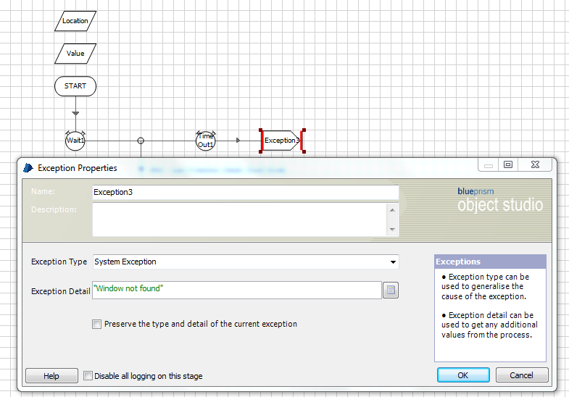
Object Design – System Exceptions
An exception occurs when the process deviates from its intended path and therefore is unable to continue. Exception handling is the process of responding to and catering to this possibility
Debugging
To help with debugging, it is important to ensure detailed feedback is provided on the exception.
This is accomplished by standardising “Exception Type” and “Exception Detail”.
Exception Type = System Exception
Used for all Exceptions in the object.
Exception Detail = “<XX> window not found”
Used for initial time out when window cannot be found
Exception Detail = [Location]&” not found”
Used for exception on choice stage when criterion is not defined

Slide 20
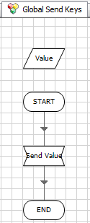
Object Design – Global Send Keys
All objects have a dedicated “Global Send Keys” page. The purpose of this page is to feed through any keystrokes from the keyboard.
Examples of keys include:
{ENTER}
{TAB}
{PGDN}
{SHIFT}+{F1}
Care must be taken when using the Global Send Keys page to interact with an application. It should not be used as the first option since the keys can interact with unexpected elements/popups.
Flow Example: Global Send Keys (Navigate)
The navigate stage is used to send through keys to the application. It has one input and no outputs:
Value (input) – the keystroke being sent

Slide 21
3. Work Queue Management

Slide 22
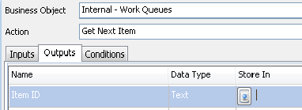
Work Queues
Almost every Blue Prism Process will make use of a work queue, which is essentially a list of jobs, or cases. New cases can be fed into the queue, and the queue can be updated with results as each case is worked
A work queue provides the following features:
Multiple machines can work from the same queue at the same time, each retrieving different cases to work.
An individual case can be marked as ‘complete’ if it has been worked satisfactorily, or marked as an ‘exception’, if it could not be completed.
Queued work can be monitored and maintained from Control Room.
MI such as volumes, performance levels and exception details can be extracted from queue data.
Work Queue Actions
Add to Queue
Get Next Work Item
Mark Complete
Mark Exception
Get Next Work Item
** The process requests to navigate into the object element (passing in the location only

Slide 23
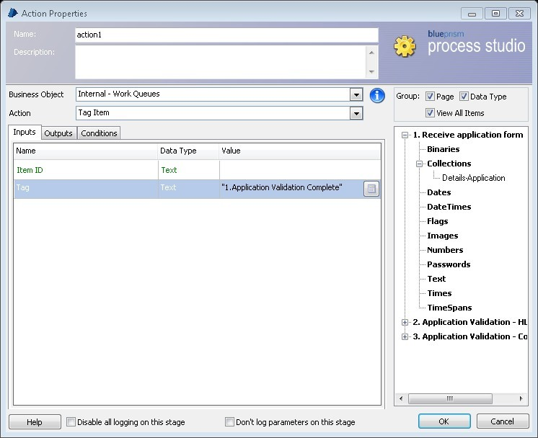
Process Tags
Process Tags allow the process controller to identify which stage the process is at
Using an incremental naming convention such as 1, 2, 3, allows for the tags to be listed in the correct order in the logs
Examples:
Application Form Read
HLS Validation Complete
CHLM Created

Slide 24
4. Release Management

Slide 25
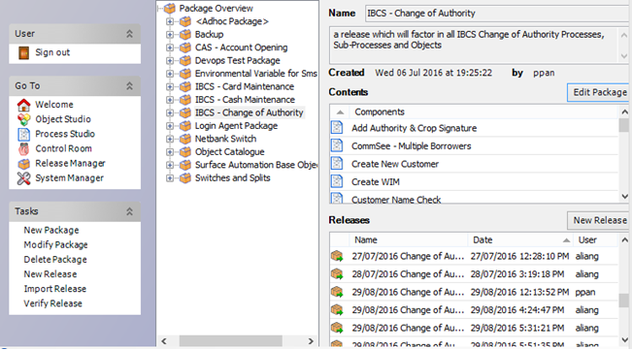
Release Management
Release Management is a critical activity in maintain the quality of the solution as the code moves through the development lifecycle
Regular release management enables:
End-to-end testing is improved (as no defects occur due to missing objects or missing processes in the release)
Higher quality in code management
How to create / manage a release
Create > Select new package from ‘Package Overview’
Manage Existing > Select ‘Edit Package’
Name Release using descriptive words of the process
Annotate the process description
Drag all associated components of the process into the release
Release Manager User Interface
Export a release
Select ‘New Release’
Enter in dd/mm/yyyy_<Process Name>.bprelease
Save all releases in a centralised shared folder

Slide 26
5. Exception Handling

Slide 27
Exception Handling
Almost every Blue Prism Process will make use of exception handling, which is a way of processing for non-ideal scenarios. Exception handling allows us to capture what went wrong and attempt to continue a process
Exception handling can be used in the following ways:
Capturing errors so that a process can continue via “recover” and “resume”
Providing details of an exception via the “Exception Detail” element
Categorising exceptions via the “Exception Type” element
Can be handled across different process layers

Slide 28

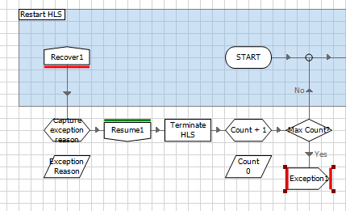
Good Exception Handling Practice
Exceptions should bubble up and be handled in the main page (unless a specific action is required on a sub page)
Exceptions should be differentiated on the main page via a choice stage which identifies “Exception Type”
“Exceptions Type” should be defined whenever they are raised in lower process stages
Exceptions raised in sub-processes should never continue to an end stage. This is so that a process does not continue as usual after an error has occurred.
Exceptions should be raised using blocks
Recover stages should be the only error handling component that is inside a block
Exception messages stored in ‘Exception Detail’ should be detailed

